Slide 1
Presentation at Toyo University
東洋大学
29/04/2015
Introduction to the economics of innovation:
from the theory of organizations to creative management
Jean-Alain Héraud
Professor of Economics
Université de Strasbourg
Researcher at BETA
Jean-Alain Héraud

Slide 2
1. Introduction
Examples of organizations
Private hierarchies like firms or NGOs
Public institutions
Sociological institutions, communities….
Markets?
Jean-Alain Héraud

Slide 3
Organizations are an important topic for management, economics, political sciences, etc.
Structure of the firm
hierachical power,
information system,…
Organizations of organizations
Branch organizations
Partnerships (strategic alliances)
Subcontractors
Illegal agreements like cartels, price fixing…
Other sorts of economic organizations like trade unions
Jean-Alain Héraud

Slide 4
What is their general functions?
Coordination of individual actions
Hypothesis: several coordinated actors are more efficient than one actor in isolation
Why?: division of labor, economies of scale and scope,…
Modalities: hierarchical power? psycho-sociological control?
Distribution of means of production and revenues
Is it more efficient in organizations (hierachies) than in markets (invisible hand)?
Learning effects
Individual and collective training (formal and unformal)
Jean-Alain Héraud

Slide 5
Variety of modalities
Private firms, public institutions, associations (NGO) and even markets have about the same general functions
But the ways of implementing the functions are very different. For example:
- Firms and institutions:hierarchical power
- NGOs: values, conviction...
- Markets: prices
Important differences in decision procedures as well

Slide 6
2. Decision in organizations
How to decide collectively?
Is it more efficient collectively than individually?
If yes, decision making could be one explanation for the existence of organizations
If not, is it more difficult? Is it just different? Is it impossible? (we need the boss for that)
Jean-Alain Héraud

Slide 7
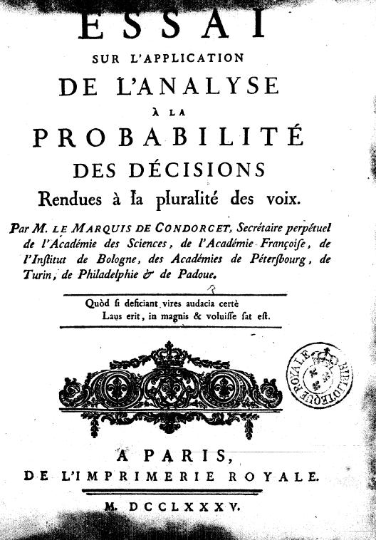
An old issue
1785
Jean-Alain Héraud

Slide 8
Collective rationality?
Condorcet paradox
Nicolas de Condorcet (1785)
Example of impossibility in some public votes with usual democratic rules (majority vote), to find a coherent collective decision
Kenneth Arrow
Impossibility theorem: it is not possible to make the aggregation of individual preferences into a collective utility function (welfare) without some dictatorial decision
Arrow K. J, Social Choice and Individual Values, London, 1951
Sen A. K., Collective Choice and Social Welfare, London, 1970
Jean-Alain Héraud

Slide 9
A very simple example
Voter 1: A>B>C
Voter 2: B>C>A
Voter 3: C>A>B
Read > : « preferred to »
Jean-Alain Héraud

Slide 10
Political implication for modern democracies and management structures
A democracy based on systematic referendum processes is either not possible, or would lead to incoherent policy
Representative democracy is a possible solution (better than dictatorial)
Theoretical conclusion: collective rationality cannot be absolute (in the sense of classical economic rationality which is individual): it is procedural (procedure’s bias)
Herbert Simon, James March.
Jean-Alain Héraud

Slide 11
The organization as a set of routines
By definition, an organization implements procedures and many sorts of routines
Through procedures, the coordination of activities is possible without controlling individually all members
Through behavioral standardization, horizontal coordination is possible: people are previsible, communication is easy through codified language, there is a limited set of possible actions and thoughts (concept of code book).

Slide 12
The paradox of organizational change
Evolution is necessary for most of the organizations. It is sometimes even a condition for survival
How is it possible to evolve within a system defined as a set of routines?
Is organizational change decided and implemented by the hierarchy or is it a mechanism of self-organization?
Incremental changes or radical changes?

Slide 13
3. Economics of innovation
Models of evolution in other sciences: Darwin vs Lamarck in biology.
The founder of evolutionary economics and innovation theory: Josef A Schumpeter

Slide 14
Evolution of focus in innovation studies
Economics of technology (1970s)
Economics of innovation (1980s)
Economics of knowledge (1990s)
Economics of creativity (2000s)

Slide 15
Innovation as a central strategy for firms and nations
Creating and developing new products, processes and/or markets is at least an opportunity for the development of micro and macro entities
It is even sometimes a necessity for survival in a globalized, ever-changing world
Nevertheless only a minority of entrepreneurs consider creative/innovative activities as day-to-day business: it is a secondary concern because operational business issues claim the entrepreneur’s full attention
Therefore many ideas « stay on the shelf » due to lack of time, money, partners or knowledge

Slide 16
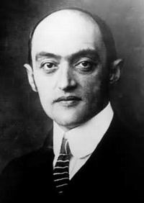
Joseph A. Schumpeter (1883-1950): the father of innovation theories
Principle of “creative destruction” (schöpferische Zerstörung)
Main works:Business Cycles: A theoretical, historical and statistical analysis of the Capitalist process (1939); Capitalism, Socialism and Democracy (1942)
Innovations according to Schumpeter:
New markets or products
New equipment
New sources of labor and raw materials
New methods of organization or management
New methods of transportation or communication
New methods of advertising and marketing
…

Slide 17
Innovation and networks
Nobody innovates alone:
Partners
Strategic alliances
Clients
Suppliers
Research centers
etc.
Externalities, material or immaterial infrastructures, ….
Knowledge communities

Slide 18
4. Economics and management of creativity
Innovation requires more than knowledge and money
Entrepreneurs (in the sense of Schumpeter) are people who have visions
A form of creativity lays at the bottom of any innovation

Slide 19
New idea + entrepreneurship
Innovation means :
New idea + entrepreneurship
The new knowledge (idea) is not necessarily in science and/or technology: can be in the fields of organisation, culture, arts, lifestyle, etc…
It is not necessarily formal knowledge (in that case, IP does not apply and/or is not necessary)
Innovation can be the result of creativity in regular economic sectors, in regular commercial organisations. Another interesting field is the developement of « creative industries ».

Slide 20
Defining creativity
Creativity is at the core of every progress in society, in particular at the origin of economic innovation.
Creativity corresponds to a positive mental attitude towards anything that is new.
"Creativity is the ability to produce work that is both novel (i.e., original, unexpected) and appropriate (i.e., useful, adaptive concerning task constraints)." Sternberg/Labort (2008)

Slide 21
Various types of creativity créativité
Creativity in art or design (new style)
Creativity in science (discovery)
Creativity in technology (invention)
Creativity in economy / society (innovation)
In any case creative people are able to "think out of the box": escape usual way of thinking

Slide 22
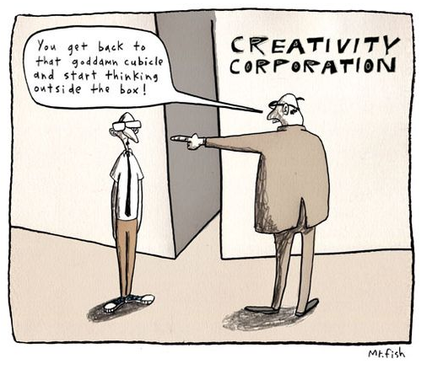
How to implement creativity
in an organization?

Slide 23
Thank you for your attention どうもありがとうございました heraud@unistra.fr jaheraud.eu
Jean-Alain Héraud

