Slide 1
Knowledge Angels in B to B: An ideal human resource for innovation
東洋大学
Tokyo
April 2015
Jean-Alain HERAUD
Professor of economics
Université de Strasbourg, France
Notes:
東洋大学

Slide 2
Document linked to the presentation
J-A Héraud 2014
E. Muller, A. Zenker, J-A Héraud
Knowledge Angels: fostering innovation in knowledge-intensive business services through creative individuals
Observations from Canada, China, France, Germany and Spain
Accenture award for research papers in economics and management of innovation, March 2013
To be published in International Management 2015
BETA (University of Strasbourg, France)
ISI (Fraunhofer Institute ISI, Karlsruhe, Germany)

Slide 3
Some articles related to the topic
J-A Héraud 2014
I. Miles et al. (1995): Knowledge-Intensive Business Services: Users, carriers and sources of innovation, European Innovation Monitoring Systems, EIMS publication N°15 .
E. Muller, A. Zenker (2001): Business services as actors of knowledge transformation: the role of KIBS in regional and national innovation systems, Research Policy, 30, 1501-1516
P. Cohendet, J-A Héraud, P. Llerena (2013): A microeconomic approach to the dynamics of knowledge creation, in P. Meusburger et al. (eds) Knowledge and the Economy, Springer (Dordrecht)

Slide 4
Innovation as a central strategy for firms and other organizations
J-A Héraud 2014
Creating and developing new products, processes and/or markets is increasingly a necessity for the development of micro and macro entities (firms, institutions, cities, regions).
Nevertheless only a minority of entrepreneurs consider creative/innovative activities as day-to-day business: it is a secondary concern because operational business issues claim the entrepreneur’s full attention
Therefore many ideas « stay on the shelf » due to lack of time, money, partners or knowledge
Transforming “ideas” into “innovations” is an act of creativity that business services (particularly KIBS) can help to perform at firm’s level.

Slide 5
Business services as central actors of innovation
J-A Héraud 2014
We can consider here all sorts of business services (BtoB), but we tend to focus on the ones that are particularly “Knowledge-intensive” (KIBS, following the definition of Miles)
Nevertheless it is not necessary to be an R&D firm to contribute to innovation. Every sort of knowledge, even unformal, can be creative
Knowledge transfer is the role of KIBS, but innovation is triggered by more complex processes. KIBS are more than pure knowledge transmitters. The cognitive process is not linear, but systemic.

Slide 6
Knowledge Angels as central actors of KIBS activity
J-A Héraud 2014
We will see how KIBS foster innovation by a series of knowledge transformations: this is fundamentally a creative activity.
The knowledge transformation occurs through translation processes, envolving a heterogeneous set of actors and contexts, outside and inside KIBS.
Certain individuals have, more than others, the capacity to bridge knowledge systems: they can translate. Since translation always involves a form of transformation (adaptation to another context), it is potentially creative.
Such a cognitive role cannot be performed by machines or organizations (the organization is a set of formal procedures or implicite routines). We need gifted individuals: KA.

Slide 7
Preliminary definitions
J-A Héraud 2014
What is knowledge? It is not pure information (that can be automatically transmitted and stored in databanks), because there is also a grammar organizing the items; a series of meta-information layers for processing the basic information.
What is innovation? It is not only scientific discovery or technical invention, it is a complex process involving many factors and actors. In addition to new knowledge, it requires entrepreneurship (Schumpeter).
What is creativity? It is novelty plus relevance (Sternberg). It is not restricted to the field of science and technology. It requires the capacity of vision, not only knowledge.
In all three cases, how can we work without specific individual capabilities?

Slide 8
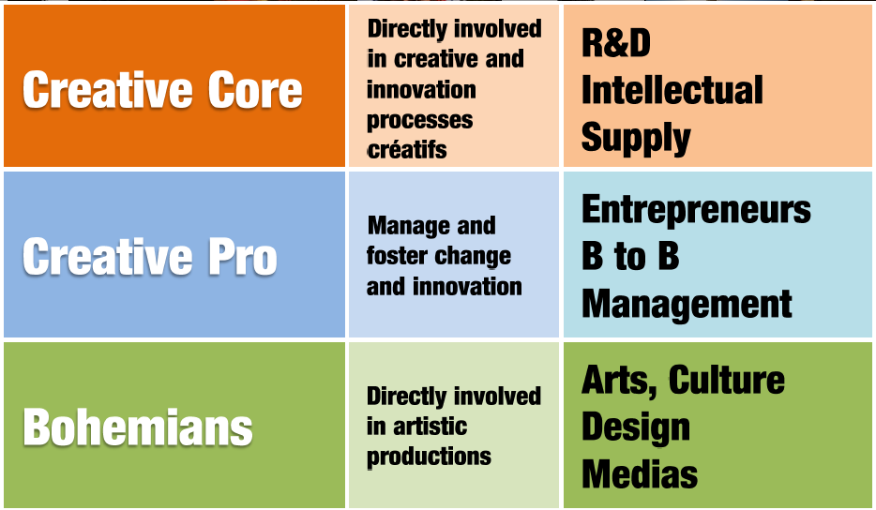
Florida’s creative class typology
J-A Héraud 2014
Source: S. Chantelot

Slide 9
Sternberg’s definition of creativity
J-A Héraud 2014
"Creativity is the ability to produce work that is both novel (i.e., original, unexpected) and appropriate (i.e., useful, adaptive concerning task constraints)."
(*) Sternberg & Lubart: Handbook of Creativity (1999, 2008)

Slide 10
« Novel and appropriate » ?
J-A Héraud 2013
« Before you build a better mousetrap, it helps to know if there are any mice out there »
Mortimer B. Zuckerman, quoted by Williams&Yang in Sternberg et al. (2008) in the chapter on organizational creativity
Comments:
If you invent a better mousetrap, you can patent it (this is technological creativity)
But if there is little or no use of it, you will never get an innovation in the sense of Schumpeter (economic creativity)

Slide 11
How can KIBS be creative in problem solving activities?
J-A Héraud 2014
They do not necessarily invent new solutions for generic problems (leading to patents, copyrights…) but:
If a consultant applies a good solution observed in a context to another context, it is a form of novelty.
Furthermore, if the consultant is a good professional, the application will be adapted to the new client’s context: the solution is appropriate.
This is not simple knowledge transfer (ordinary problem solving), but creative adaptation that could lead to innovation at the client’s level.

Slide 12
Are consultants simple knowledge brokers or knowledge translators?
J-A Héraud 2014
Metaphore of the language
To translate is not to copy-paste in another language
In translating you learn : because the process raises questions about the subject, defies your own language; can lead to errors (and there is always something to learn from errors); etc.
Translation is also creative because it forces to abstract from a context before applying to another. You get closer to the essence of things.

Slide 13
Cognitive scheme
J-A Héraud 2014
Observations are not purely recycled, they must be conceptualized

Slide 14
How can some individuals be vectors of creativity in the KIBS business?
J-A Héraud 2014
Some individuals have to a high degree the capability to recognize that a particular problem or a particular solution belongs to a general pattern. This pattern is the link between different concrete situations. A process of translation is now possible.
Such a wisdom (it is more than pure knowledge) allow them to propose the translation from one context to another:
Problem A is perceived as similar to problem B in a certain way; therefore an existing solution for A could maybe be adapted to B.
Solution X seems to have general properties; why not adapting it to other contexts?
This is the specific way in which KIBS can be very "innovative". (Of course, the final innovation will be at the level of the client firm, as well as its implementation and the economic risk).

Slide 15
Models of knowledge creation
J-A Héraud 2014
A superficial vision of creativity tends to depict innovation with a biological model of genetic crossing:
New ideas are recombinations of existing ones (like gene crossing produces new species)
In such a vision, KIBS are just intermediary actors : they benefit from their access to many firms’ knowledge bases (and other sources of knowledge too, like research institutions) for reformulating new sets of knowledge (the Lego model). A pure organizational setting (if not a good computer) could implement a research procedure of that kind.
We consider KIBS can be creative in a more conceptual way. And for that, human capabilities are crucial.

Slide 16
Empirical observations: the Kairos enquiry
J-A Héraud 2014
ISI (Karlsruhe)-BETA(Strasbourg) enquiry with colleagues from Spain, Canada, China (2007-2009)
Selection of KIBS
Identification of key individuals (potential KA)
45 personal in-depth interviews in Alsace (region of Strasbourg) and Baden-Württemberg (region of Karlsruhe), and in Barcelona, Montreal and Beijin agglomerations

Slide 17
Typical profile of KA
J-A Héraud 2014
Observations not very surprizing : relatively conform to expectations from the theory
Individuals with strong implication and devoted to the KIBS, but very autonomous and belonging to multiple communities within and outside the firm (sometimes multiple competencies like engineering and management)
They have a close relationship with strategic management of the KIBS but want to be often on the field (visiting client firms, research centers, policymakers, etc.) and like do the work (projects) by themselves
Other key words:
Freaks, vision
Freedom at work; trust co-workers
Multi-tasking
Acceptance of risk and potential failure
Relying (also) on intuitive decision

Slide 18
General results
J-A Héraud 2014
Individual characteristics
ambitious engagement in different fields (internal/ external)
motivation, fun, ambition, autodidactic learning capacity
communication + networking skills, "all-rounders"
openness, flexibility, curiosity
search for "optimal" working environment (self-realisation + corporate benefit
vision-building, problem-solving (sometimes in unconventional ways)
"multi-tasking"
Corporate characteristics
niche markets, competition
project organisation, interdisciplinarity
dynamics, teams of "freaks" and "craftsmen"
flexible project management, flat hierarchies
knowledge accession and diffusion, small / medium size
creativity as organisational paradigm
degrees of freedom, trust
acceptance of possible failure, risk-taking, quick decision-making, intuition
Locational characteristics
location in larger cities (China: capital region)
satisfaction with location, "arranged with city/ region"
integration in networks with regional actors
location: no strategic choice
appreciation of potentials and openness of location
good living conditions and employment opportunities

Slide 19
National bias
J-A Héraud 2014
KA profiles revealed relatively similar in every region, but slightly biased towards certain aspects of the theoretical profile:
China: “solution provider”
France: “idea giver”
Germany: “knowledge broker”
Spain: “facilitator”
Canada: “business pusher”

Slide 20
As a conclusion: some sort of hazardous philosophical digression
間 ↔️ 場

Slide 21
Many thanks for your attention
J-A Héraud 2014
Jean-Alain HÉRAUD
heraud@unistra.fr
Personal website
jaheraud.eu

